Slide 1
Insights from data
Lecture 3
Data Importing, Preprocessing, and Cleaning

Slide 2
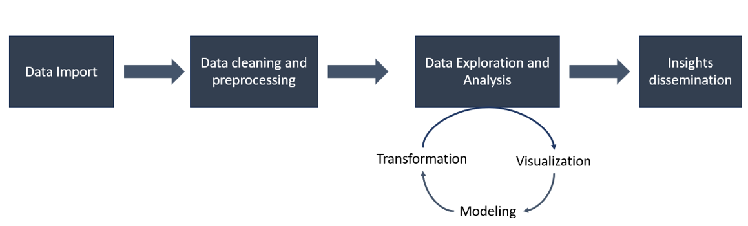
Insights from data
Data import and export
Data manipulation
Apply family functions
Data cleaning and preparation

Slide 3
Importing data into R
Different ways of loading data into R:
Data is available in an R-format (.Rdata)
Data is available in non-R format (e.g., csv, excel)
(https://www.datacamp.com/tutorial/r-data-import-tutorial)
load("~/Insights from data/data.Rdata")

Slide 4
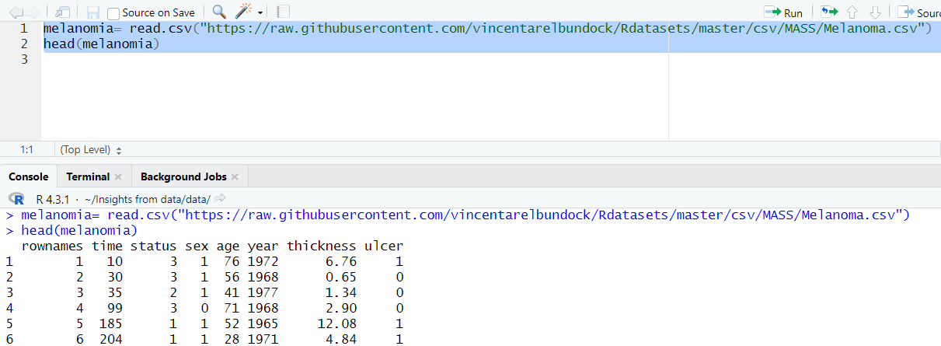
Importing data into R from CSV file
The comma-separated values (.csv) format is probably the format most widely used in the open-source community
Reading data into R using read.csv() function

Slide 5
Importing data into R from EXCEL file
Install and load “readxl” package.
Import the Excel file:
install.packages(“readxl")
library(readxl)
data <- read_excel("path/file_example.xlsx")
Head(data

Slide 6
How to Export Data From R
Saving data as R object:
Save( melanomia, file = "~/Insights from data/2024/Rcodes_data/melanomia.Rdata")
Saving data as CSV/EXCEL file:
write.csv(melanomia, file = "~/Insights from data/2024/Rcodes_data/melanomia.csv")
install.packages("writexl")
library(writexl)
write_xlsx(melanomia, path= "~/Insights from data/2024/Rcodes_data/melanomia.xlsx")

Slide 7
Data Preparation and Cleaning in R
Data Tidiness Challenges: Often, data isn’t in a single, clean format. It may be scattered across multiple sources or contain irrelevant information, making analysis difficult.
Importance of Preprocessing: Organizing data properly is essential for accurate and efficient analysis.
The tidyverse Package: The tidyverse simplifies data cleaning by combining tools for common tasks

Slide 8
What is Tidyverse?
install.packages("tidyverse")
Tidyverse: A collection of R packages designed to make data manipulation, visualization, and analysis more straightforward and consistent.
The tidyverse operates on the assumption that data should be “tidy”.
What is a Tidy Data?
Each variable forms a column.
Each observation forms a row.
Each type of observational unit forms a table.
Tidy Data Benefits
Improved readability: Well-structured data makes analysis more intuitive and manageable.
Consistency: Tidy data aligns datasets to a standardized format, making it easier to perform complex transformations.
Ease of integration: Tidyverse packages, like dplyr and ggplot2, are optimized for working with tidy data, enhancing efficiency in data cleaning, exploration, and visualization.
Key Packages in Tidyverse: dplyr (Data manipulation), ggplot2: (Data visualization), tidyr: (Data tidying), readr: (Data importing)
https://vita.had.co.nz/papers/tidy-data.pdf
install.packages("tidyverse")
library(tidyverse)

Slide 9
Data manipulation (dplyr )
Main data manipulation functions in dplyr package
filter(): Select specific rows based on defined value conditions.
distinct(): Eliminate duplicate rows
arrange(): Rearrange the order of rows according to specified variables.
select(): Choose and extract columns (variables) by their respective names.
rename(): Renames columns.
mutate() and transmute(): Add/create new variables
summarise(): Calculate and derive statistical summaries, such as mean or sum
Reference (https://statisticsglobe.com/dplyr-r-package)

Slide 10
Data Selection
select()/slice(): Choose and extract columns (variables)/rows by their respective names.
Package dplyr allows to use the forward-pipe chaining operator (%>%) for combining multiple operations. For example, x %>% f is equivalent to f(x).
Using the pipe (%>%), the output of each operation is passed to the next operation.
library(tidyverse)
mydata= as_tibble(iris)
#Selecting specific columns
aa <- mydata %>% select (Sepal.Length, Sepal.Width)
#Selecting all columns excep Species
bb <- mydata %>% select (-Species)
# Selecting rows 1 to 5
aa<- mydata %>%slice(1:5)
#Removing rows 1 to 5
bb<- mydata %>%slice(-1:-5)

Slide 11
Filtering data
filter(): Select specific rows based on defined value conditions
Filtering & selecting
mydata %>% filter(Species=="setosa", Sepal.Length > 5, Sepal.Width < 4)
mydata %>% filter(Species == "setosa") %>% select (Petal.Length,Petal.Width)

Slide 12
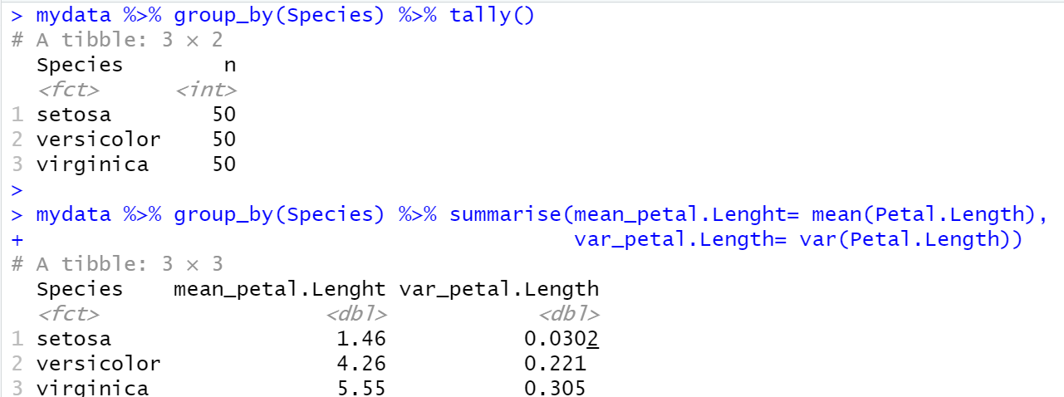
Summarizing data
Counting the number of different Species: grouping data by Species using group_by(), and then counting the number of rows in each group using tally()
Finding the mean and variance of Petal.Length in each Species

Slide 13
R Apply Family
The apply family consists of vectorized functions. The most common forms of apply functions:
apply(X, margin, fun,..):apply a function to the rows or columns of matrices or data frames.
lapply(x, fun,..): apply a function to each element of the list, return a list
sapply(x, fun,..): apply a function to each element of the list, returns the result into a vector or matrix
tapply(x, index, fun,.., simplify): breaks the data set up into groups and applies a function to each group.
Reference(https://www.learnbyexample.org/r-apply-functions/)

Slide 14
R Apply Family
# Apply mean function across columns (2) in the numeric subset of iris
meanval= apply(iris[, 1:4], 2, mean)
# Apply range function to each column and return as a list
res <- lapply(iris[, 1:4], range)
#Simplify output to a matrix if possible
res <-sapply(iris[, 1:4], range)
# Apply mean function within species groups for Petal.Length
res <- tapply(iris$Petal.Length, iris$Species, mean)

Slide 15
Class Exercise
Use apply() to calculate the mean and standard deviation for the numeric columns in the dataset.
Use dplyr for data manipulation and apply functions to perform calculations and summaries on the mtcars dataset.
1) Explore the Dataset Use the head(), summary(), and str() functions to understand the dataset.
2) Data Manipulation with dplyr:
Group the dataset by cyl and calculate the average mpg for each cylinder group.
Calculate the total horsepower (hp) for each transmission type (am).
3) Using the apply Family of Functions
Use the apply() function to calculate mean and standard deviation for numerical columns
Use lapply() to calculate the range of each column and return as list
Use sapply() to calculate the range of each column and return as matrix.

Slide 16
Results
head(mtcars)
summary(mtcars)
str(mtcars)
#a. Calculate average mpg per cylinder group:
avg_mpg_by_cyl <- mtcars %>% group_by(cyl) %>% summarize(Average_MPG = mean(mpg))
#b. Calculate total horsepower for each transmission type:
total_hp_by_am <- mtcars %>% group_by(am) %>% summarize(Total_Horsepower = sum(hp))print(total_hp_by_am)
# Calculate mean and standard deviation for numerical columns
meanval= apply(mtcars, 2, mean)
sdval= apply(mtcars, 2, sd)
#Apply range function to each column and return as a list
res <- lapply(mtcars, range)
#Apply range function to each column and return as a matrix
res <- sapply(mtcars, range)

Slide 17
Data cleaning and preparations
Variable/feature selection
Missing values
Outlier detection

Slide 18
Variable selection
Purpose: Identifying informative variables and excluding irrelevant ones to enhance model performance and interpretability.
Variable Selection Methodologies:
Filtering Approaches: Employing methods like variance filtering to select variables with significant variance and exclude those with low variability.
Statistical Modeling/Machine Learning Approaches: Utilizing advanced statistical modeling and machine learning techniques to identify key variables based on their predictive power and contribution to the model's performance

Slide 19
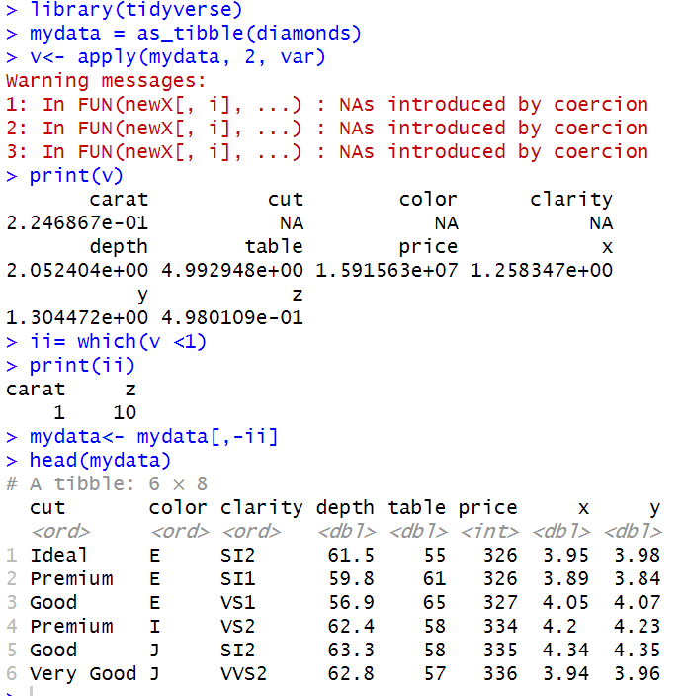
Low variance filtering
Selecting variables with higher variance and excluding low variance variables
library(tidyverse)
mydata = as_tibble(diamonds)
v<- apply(mydata, 2, var)
print(v)
ii= which(v <1)
print(ii)
mydata<- mydata[,-ii]
head(mydata)

Slide 20
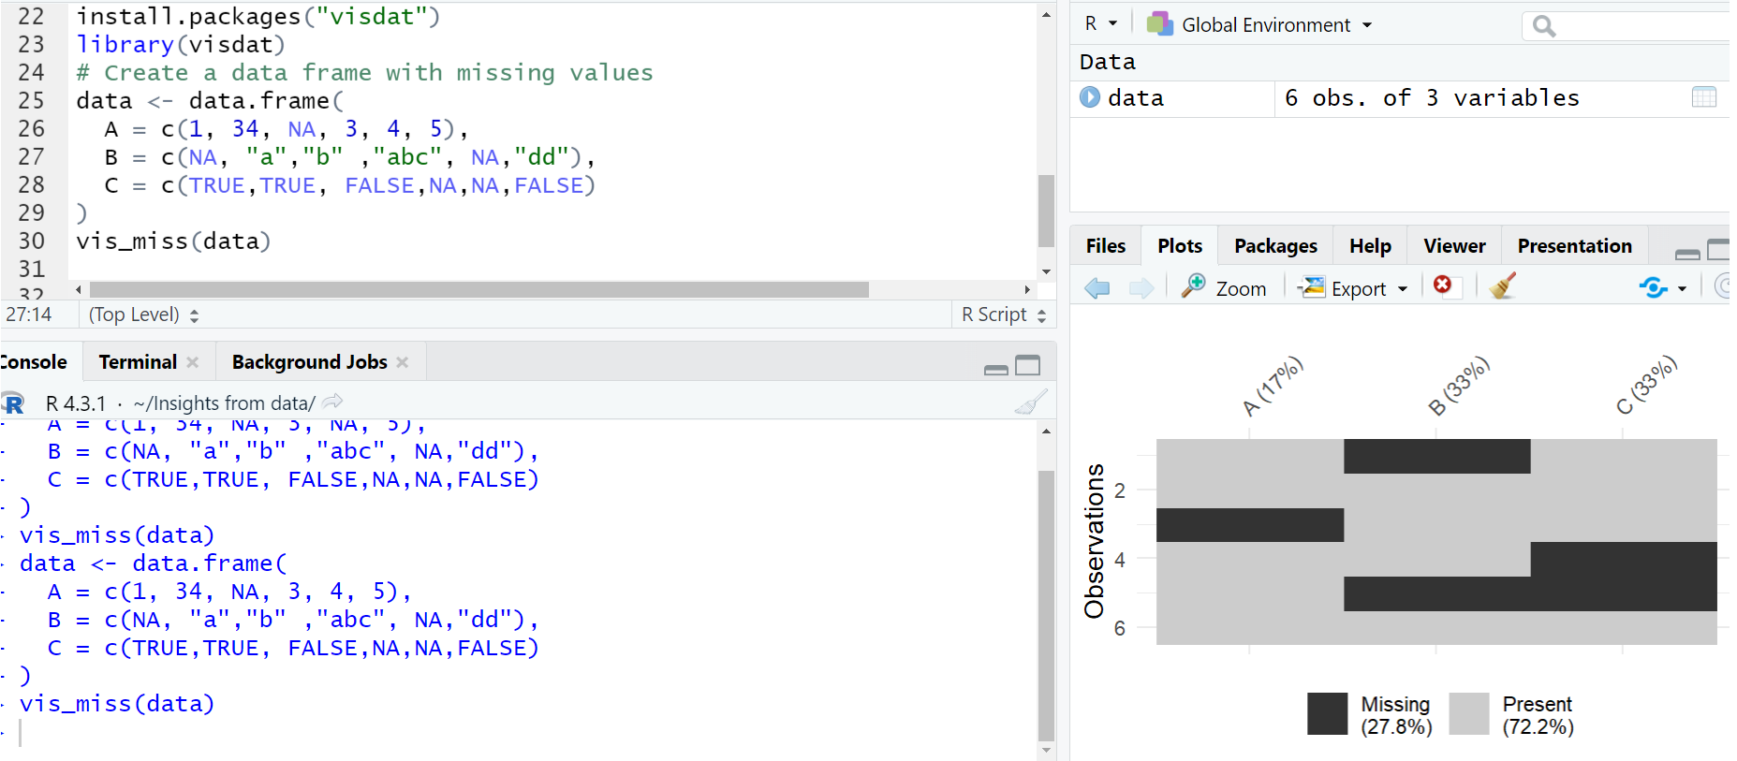
Missing values in R
Properties of Missing Values:
For testing objects that are NA use is.na()
For testing objects that are NaN use is.nan()
Removing NA or NaN values
Visualization of missing values of a dataset
x= c( 1,2,3, NA, 5,6 ,NA, 98, NA)
ind= is.na(x)
x=x[-which(is.na(x))]

Slide 21
How to deal with missing values
Removing the observations with missing values
Variable exclusion: If a specific variable/feature has more missing values compared to other variables and is deemed less critical, it can be removed.
Imputation technique: Utilizing mean, median, or mode values to replace missing values, maintaining data integrity and completeness
Predictive imputation: Predicting the missing variable from the other observations using predictive modeling

Slide 22
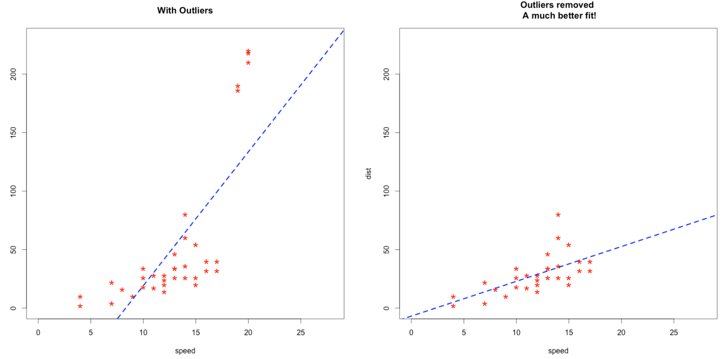
Outliers
Outliers are values that significantly differ from the majority of the other data points in a set.
Outliers in data can change the fit estimate and prediction
Figure from: https://www.r-bloggers.com/2016/12/outlier-detection-and-treatment-with-r/

Slide 23
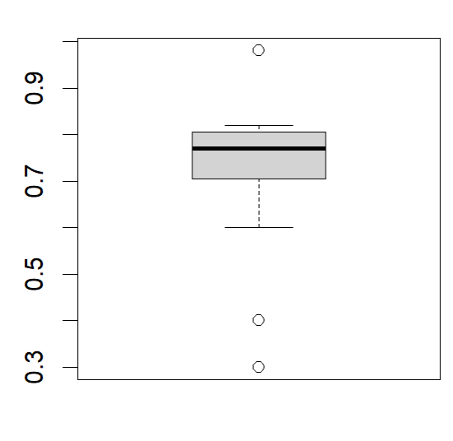
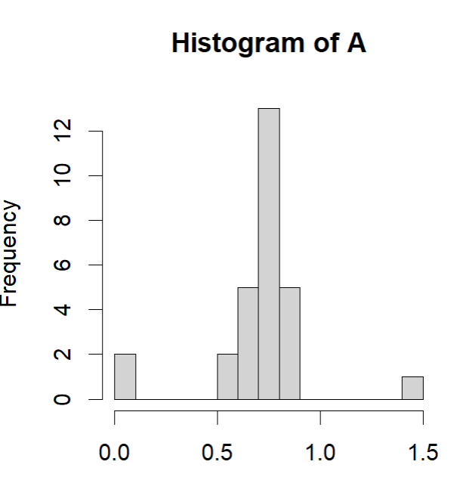
Outlier detection with visualization techniques
Box plots
Histogram

Slide 24
How to deal with outliers
Removing outliers
Replacing outliers with NA and treating them as missing values in the data analyses proses
Variable exclusion
Imputation technique
Predictive imputation

Slide 25
Class Exercise
load diamond dataset: data(diamonds)
Is there any missing values in diamond dataset? Visualize with vis_miss function.
Visualize the distribution of the 'carat' variable using a histogram. Use boxplot to visualize outliers in 'carat' variable .

Slide 26
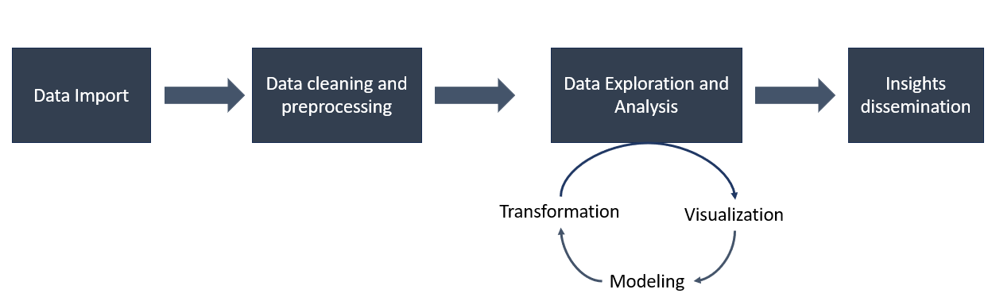
Summary
Data import and export
Data manipulation
Apply family functions
Data cleaning and preparation: variable selection, missing values & outliers

Slide 27
Next
Data visualization (ggplot2)
Exploratory data analysis
We have guest lecture on next Friday (08.11.2024) at 12-14, by Pauli Miettinen

